Slide 1

Mind Charge

Slide 2
Table of contents
01
04
02
05
03
Project OverVeiw
Strategy
Market Research
Content Calender
SWOT Analysis

Slide 3

01
Project OverVeiw

Slide 4
Project OverVeiw
We plan to create campaigns that raise awareness about
mental well-being and guide teenagers to stay away from
harmful habits like drugs and pornography. We want to share
content that speaks their language and makes them feel supported.
Objectives:
Encourage healthy habits that improve mental health.
Show the risks of harmful addictions in a simple and clear way.
Help teenagers grow their confidence and choose healthier
alternatives.
We believe this project can truly make a difference by
helping teenagers make better choices for a brighter future.

Slide 5
Target audience
Collecting data on teenagers interests and analyzing the data to understand how to deliver content to them correctly.
-Teenagers between 12 – 17 years old
-Adults aged 35 and above.
We focused on designing simple content with clear and modern words, also avoiding pretentiousness.

Slide 6

Market Research

Slide 7
Market Research
Societal Trends
Audience Size
People are starting to pay more attention to adolescent mental health. The internet has become the primary source of information.- Some people are still afraid of the idea of psychological treatment. The government and some institutions have started supporting mental health initiatives.
Approximately 48.7 million Facebook users in Egypt in 2025. Assuming that the 12-17 age group represents roughly 10-15% of this number, the potential Facebook audience from this age group is approximately 4.8-7.3 million people.
Teenage Behavior
They prefer short, fast-paced content (like TikTok and Reels). They are greatly influenced by their friends or influencers who speak openly.They look for a group or community that makes them feel less alone.Sometimes they need help but don't know how to ask for it.
Factors that Encourage Their Engagement
Confidentiality is paramount.
It must be easily accessible via mobile. They prefer free or inexpensive services. They trust professionals more.
Parental support is crucial if they reach
the treatment stage.

Slide 8
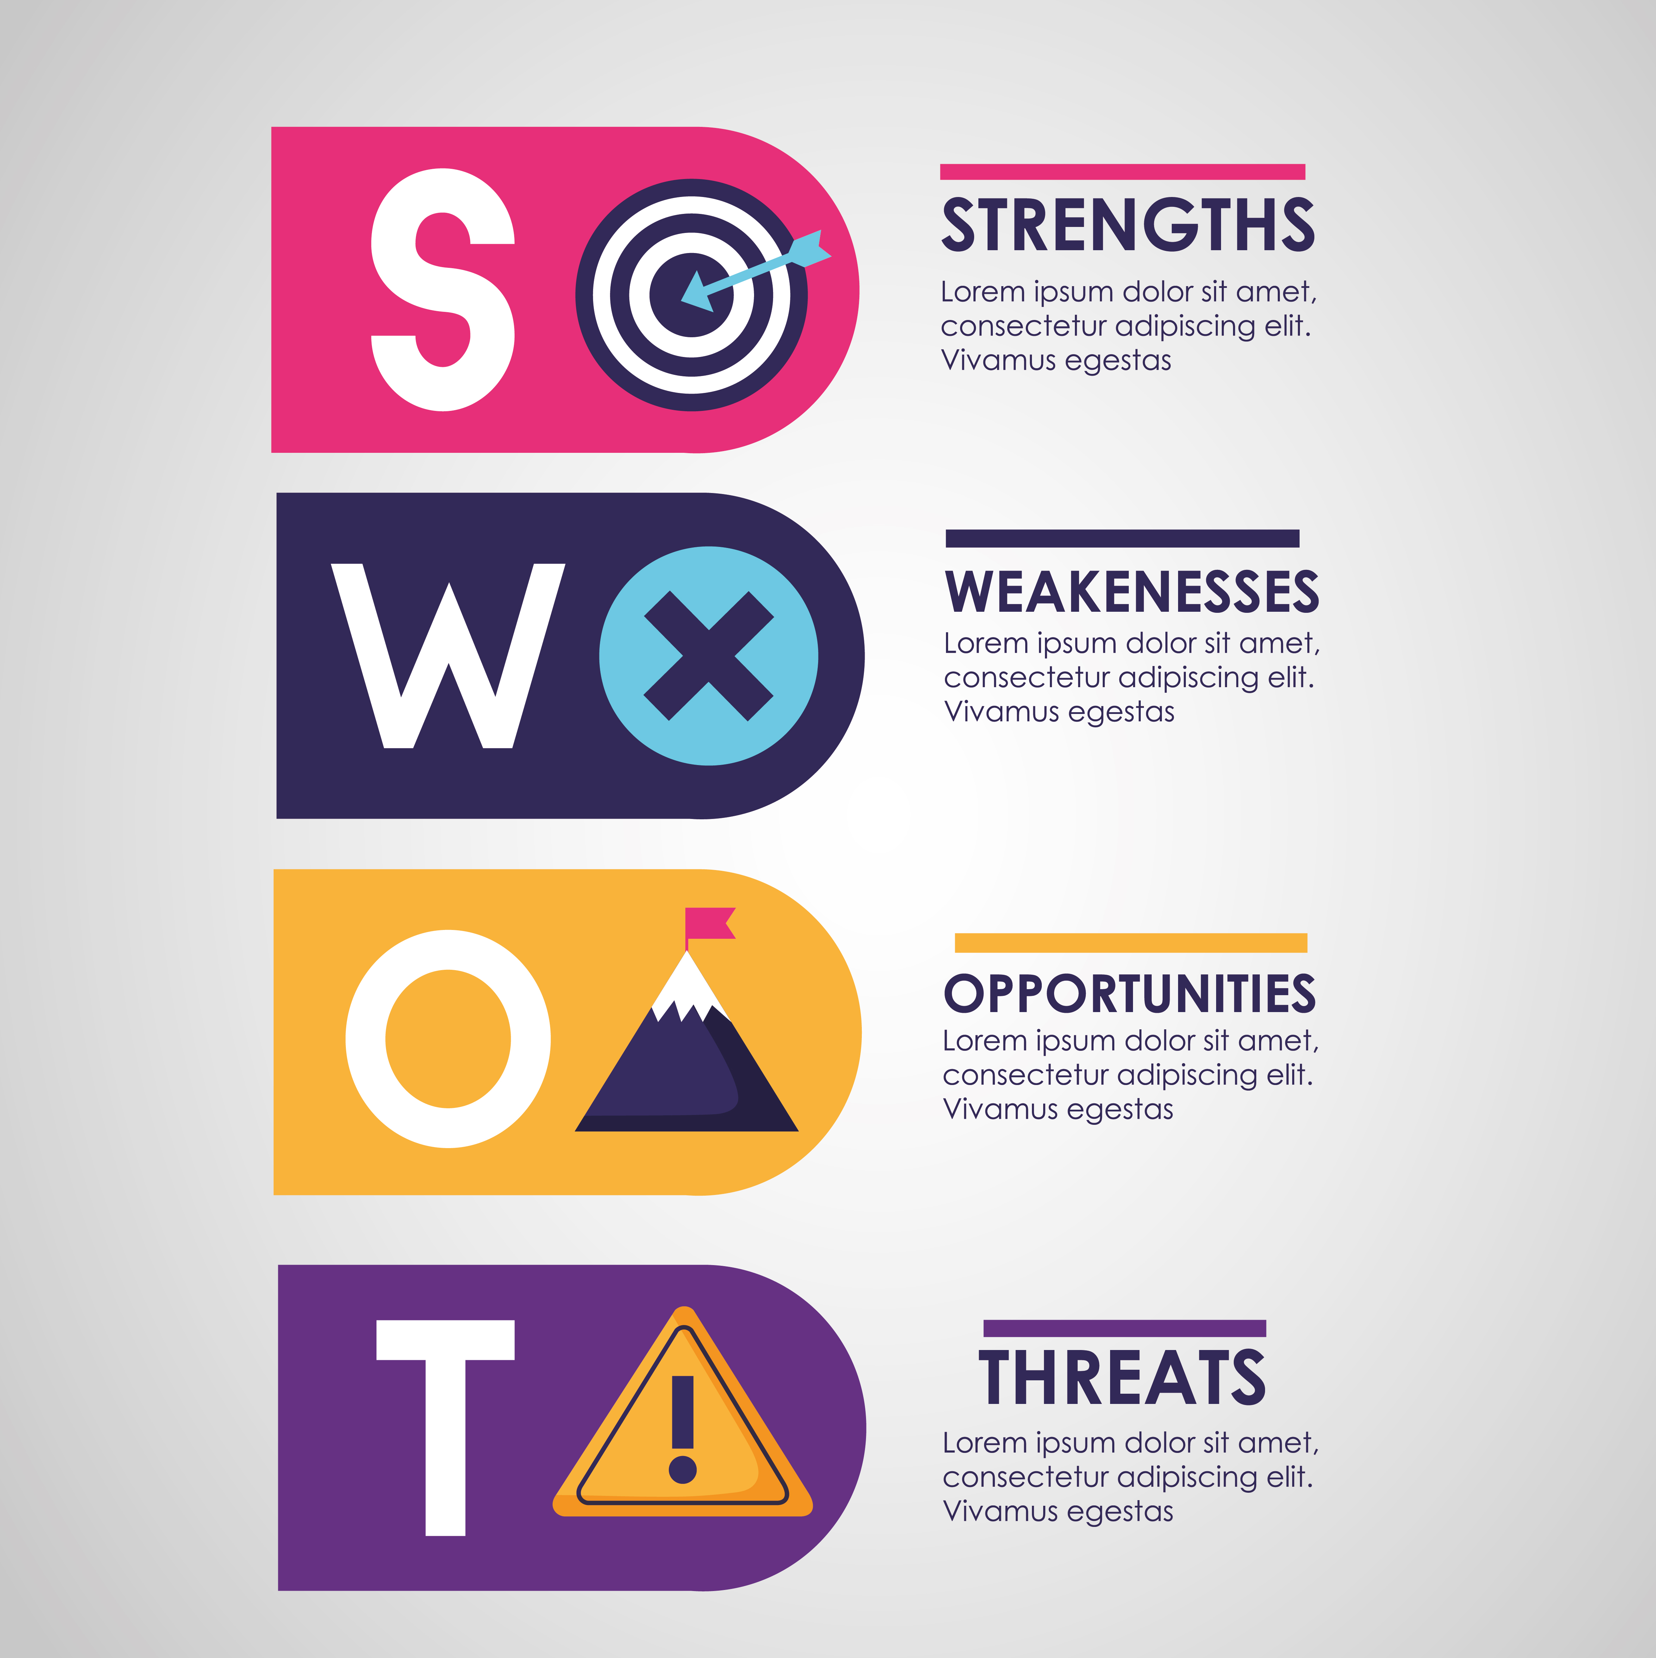
SWOT Analysis

Slide 9
SWOT Analysis
Strengths
Weaknesses
Experienced team in developing awareness materials (needs further validation).
Lack of clarity in team roles and responsibilities.
Inefficient task distribution and organization.
Weak communication between the leader and members, and among team members themselves.
Limited leadership and follow-up.
Challenges in handling and resolving technical or personal team issues.
Need for continuous motivation from the leader.
No defined KPIs to measure individual performance.
Lack of performance evaluation based on KPIs to enable improvement.
Still at an early stage with no followers.
Opportunities
Easy access to social media and adult content platforms (needs further validation).

Slide 10

Strategy

Slide 11
Strategy
1) Identity & Core Message
Main Goal
Increase awareness about mental health among teenagers and teach them skills for emotional regulation, dealing with anxiety, and building confidence. 2) Target Audience
Primary Audience
Teenagers aged 13–19
Middle and high school students
Teens struggling with anxiety, self-esteem, peer pressure, or academic stress
Secondary Audiences
Parents
Schools
Psychologists
Youth-focused influencers
3) Visual & Communication Identity
Tone of Voice
Youthful, simple, and friendly
Calming color palette (green, blue, lavender)
Language that resonates with teens 4) Marketing Channels
A) Social Media (Main Platform)
Best platforms:
facebook
Instagram Reels
YouTube Shorts
Content Ideas:
Short posts on:
Exam stress
Anxiety coping skills
Healthy friendships
Social media pressure
Communication tips

Slide 12



How to show our content
There are many platforms on which content is displayed daily in various forms.

Slide 13

Facebook
Facebook is one of the most popular social media platforms around the world and it was chosen for several reasons.
The target audience is present on it.
It is easy to use.
We discussed that we will start using Facebook as an initial phase to measure the results on it, and then subsequently Instagram and TikTok.

Slide 14

Work Stages
Choosing an expressive name.
We have identified the appropriate ideas.
Identifying suitable ideas.
Start publishing and appearing as soon as possible.

Slide 15
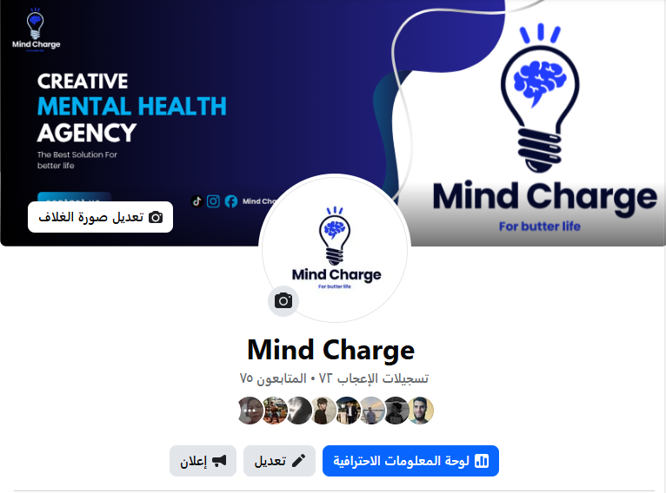
Start of publication

Slide 16
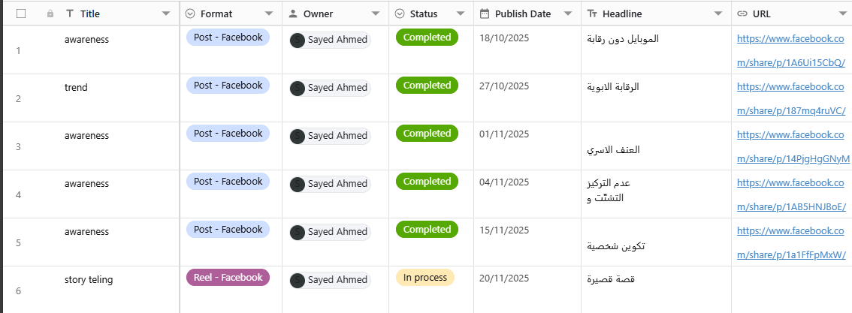
Content Calender

Slide 17
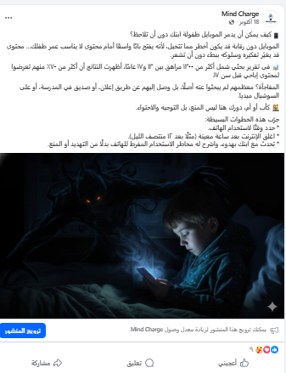

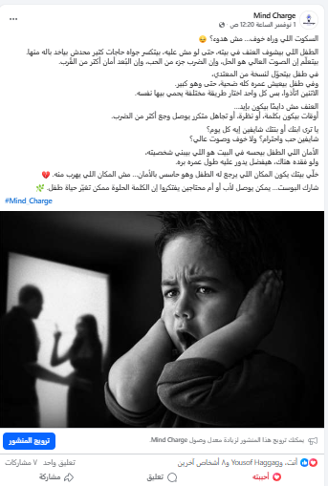
posts

Slide 18
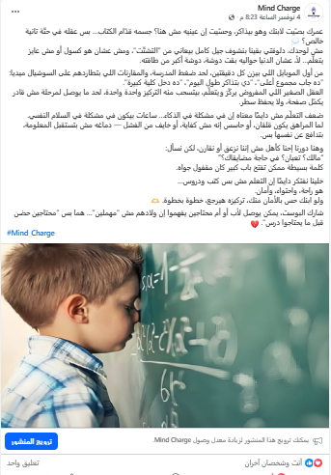

posts

Slide 19

The Advertising
We focused on making the advertisement simple, fast, and unpretentious. That's why we chose storytelling. For several reasons:
it grabs attention quickly
makes it easier to understand
enhances persuasiveness, etc.
We took into consideration that the advertisement's wording should be easy to understand and clear so that it achieves the expected results.

Slide 20
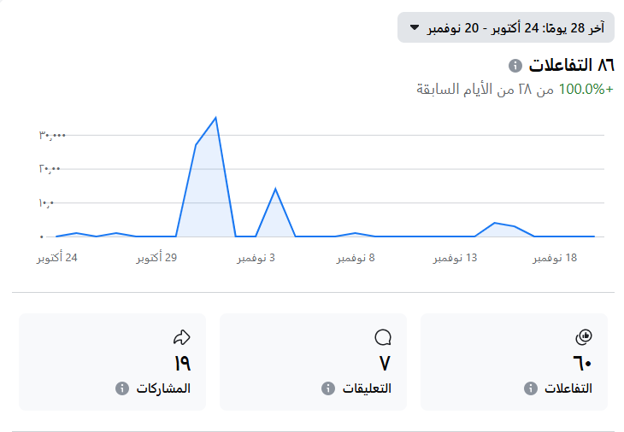
Results

Slide 21
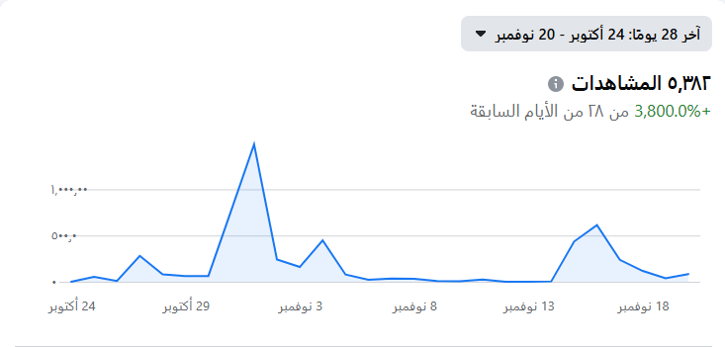

Slide 22

Thanks
Does anyone have any questions?
Mind Charg @facebook.com

